Slide 1



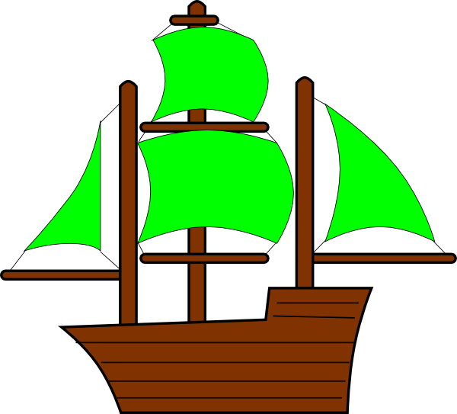






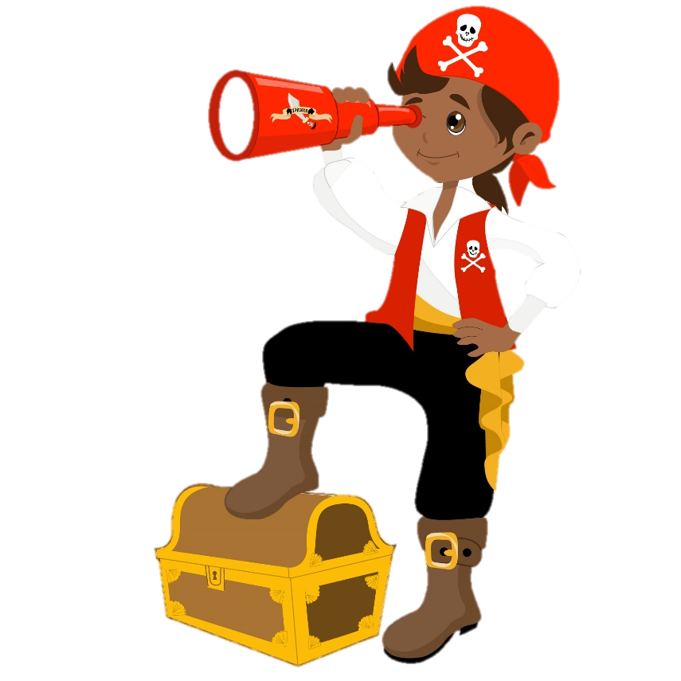
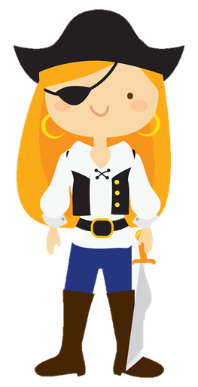
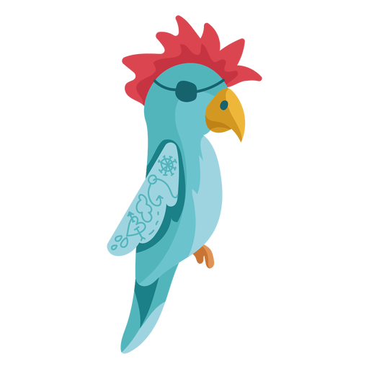
KS1 Reading Gems
Sail between the lines
Captain Define
Inference Ship
Raf
Retrieve
Sally
Sequence
Polly Predict

Slide 2
Captain Define
Raf
Retrieve
Raf Retrieve is a very clever pirate! He loves to read and remembers everything he sees in texts and stories! He loves questions which start with…
Which…? What…? How…? Where…? When…? Why…? Who…?
Captain Define knows more than just “Arr!” He loves finding vocabulary in texts to help him understand what he’s reading!
Can you be like Captain Define?

Slide 3
Sally
Sequence
Sail between the lines
Inference Ship
Sally Sequence is very organised! She needs everything to be in the correct order in stories. She can tell you what happens first, next, after, last and the beginning, middle and end.
Can you sequence the text?
The Inference Ship will voyage through seas of books looking for answers to tricky questions. Sometimes the answers are hidden and it has to sail between the lines to find them.
Look for Why? How? When? Can you…?

Slide 4
Polly Predict
Find the Treasure Hidden in Text!
Polly Predict knows everything before it happens! She reads the text and can predict what happens next. Polly also likes to think of different things that could happen in the text that aren’t written down.
What will happen at the end?
What do you think will happen to?

