Slide 1
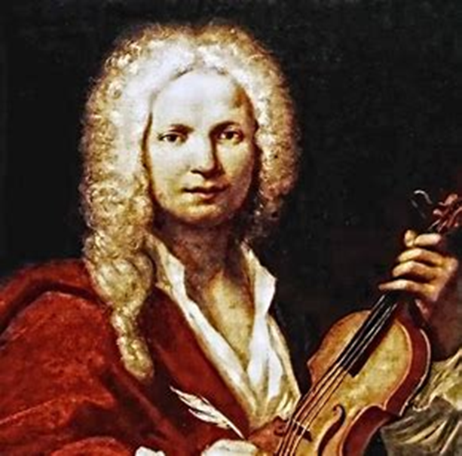
Antonio Vivaldi

Slide 2
Vivaldi was of the baroque period of music.
But what is baroque music?

Slide 3
Baroque music is a period or style of Western art music composed from approximately 1600 to 1750. This era followed the Renaissance music era, and was followed in turn by the Classical era.

Slide 4
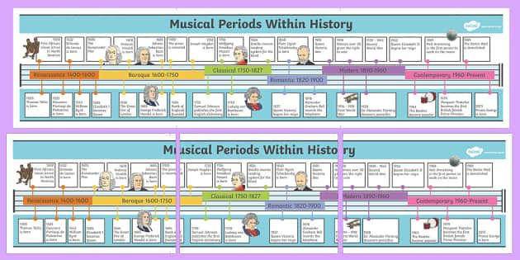

Slide 5
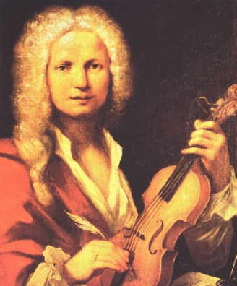
Vivaldi, by Morellon de la Cave

Slide 6
There appears to be only one existing and known portrait of Antonio Vivaldi. Francois Morellon La Cave painted the portrait in 1723. However, whether or not the painting is actually the famous composer has been disputed numerous times. There is much speculation that this is a portrait of an unknown musician. What do you think?

Slide 7
Click the link to listen to another piece of music by Vivaldi:
Vivaldi - Stabat Mater (RV 621) - Andreas Scholl, Ensemble 415 – YouTube how does this music differ from the four seasons? How does it make you feel? What instruments can you hear?

Slide 8
For next weeks assembly, see if you can draw a portrait of Vivaldi!

