Slide 1
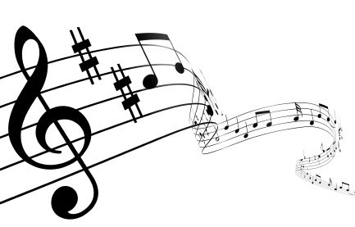
Composer of the Month

Slide 2
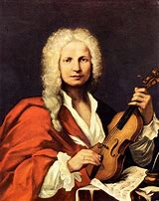
Antonio Vivaldi
1678-1741

Slide 3
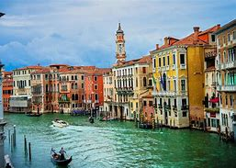
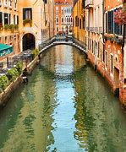
Vivaldi’s Life
Vivaldi was born in March, 1678 in Venice, Italy.
Young Antonio was taught to play the violin by his father, a professional violinist who was also a barber. Father and son toured Venice playing violin together.
At age 15, he began studies to become a priest and was nicknamed Il prêt Rosso, or The Red Priest. It is speculated that this was due to his red hair, which was a family trait.
Vivaldi's health was problematic. One of his symptoms, strettezza di petto ("tightness of the chest"), has been interpreted as a form of asthma. This did not prevent him from learning to play the violin, composing, or taking part in musical activities.

Slide 4
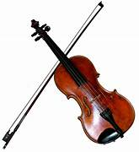
While Vivaldi is most famous as a composer, he was regarded as an exceptional technical violinist as well. The German architect Johann Friedrich Armand von Uffenbach referred to Vivaldi as "the famous composer and violinist“.
violin
In September 1703, Vivaldi (24) became maestro di violino (master of violin) at an orphanage called the Pio Ospedale della Pietà (Devout Hospital of Mercy) in Venice; although it was his talents as a violinist which probably secured him the job, he soon became a successful teacher of music there.

Slide 5
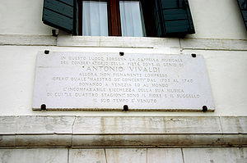
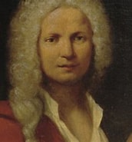
Over the next thirty years he composed most of his major works while working at the Ospedale.^{[20]} There were four similar institutions in Venice; their purpose was to give shelter and education to children who were abandoned or orphaned, or whose families could not support them.
The boys learned a trade and had to leave when they reached the age of fifteen. The girls received a musical education, and the most talented among them stayed and became members of the Ospedale's renowned orchestra and choir.

Slide 6
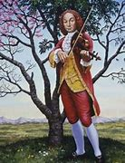
Listen to a piece of Antonio Vivaldi’s work.
What do you think of the piece? Do you like it? If so why, if not why?
Four Seasons ~ Vivaldi - YouTube
Your task this week is to find out 3 facts about Venice, where Vivaldi was born and 3 facts about Vivaldi.
Bring your facts to Mrs Plimmer and I will add them to next week’s power point!

